Slide 1
Lecture 15 – Tuples and Dictionaries
Tuples, keys and values for dictionaries
Kok-Seng Wong | 2021

Slide 2
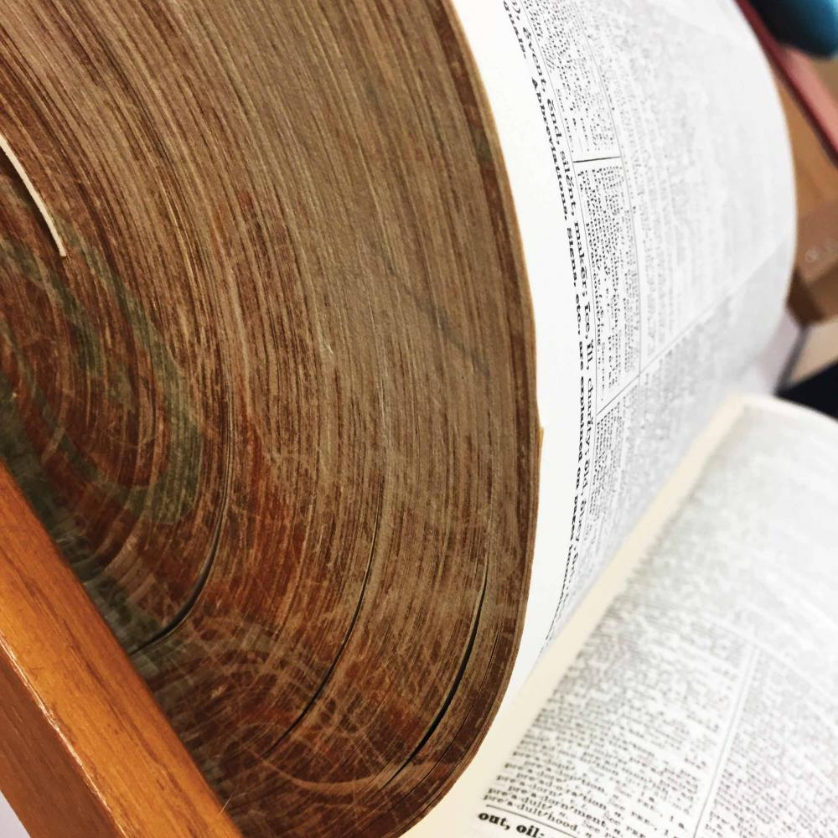
Motivation example 1
[source]

Slide 3
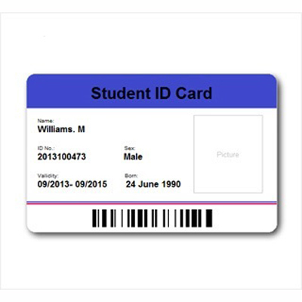
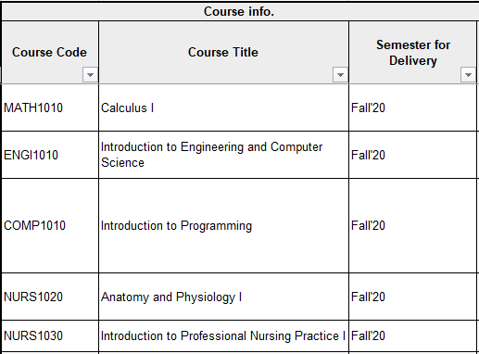
Motivation example 2
[source]

Slide 4
Learning outcomes
Upon the completion of this lecture, students will be able to:
understand the important characteristics of tuples and dictionaries in Python.
define tuples and dictionaries in Python program.

Slide 5
tuples

Slide 6
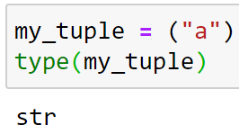
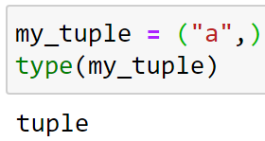
Creating a tuple
Tuple: placing all elements inside parentheses separated by commas
Tuple with a singe element:
enclose tuples in parentheses
my_tuple = ("a", "e", "i", "o", "u")
Must include a comma at the end!

Slide 7
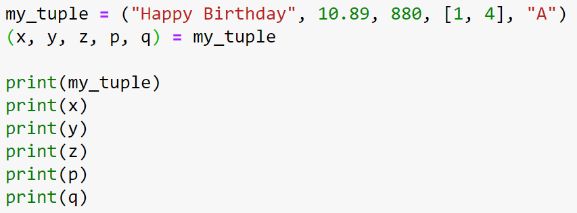
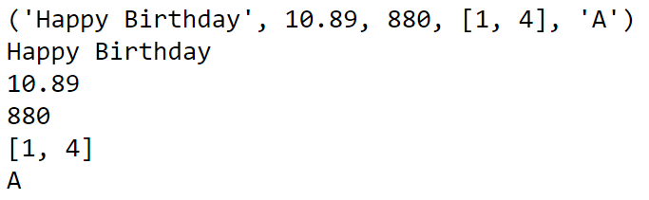
Tuple unpacking
Tuple unpacking: extract tuple elements into a single variable

Slide 8
Class practice
>>> enemy_list = ("Rohit", "Thomas", "Billy")
>>> (e1, e2, e3, e4) = enemy_list
ValueError: not enough values to unpack (expected 4, got 3)

Slide 9
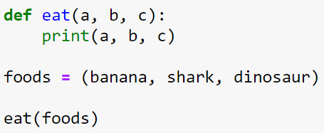
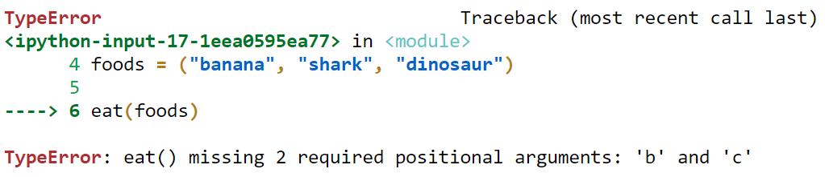
Class practice
eat(*foods)
use * operator to unpack the tuple so that all elements can be passed as different parameters

Slide 10
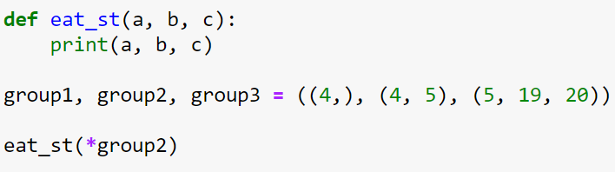
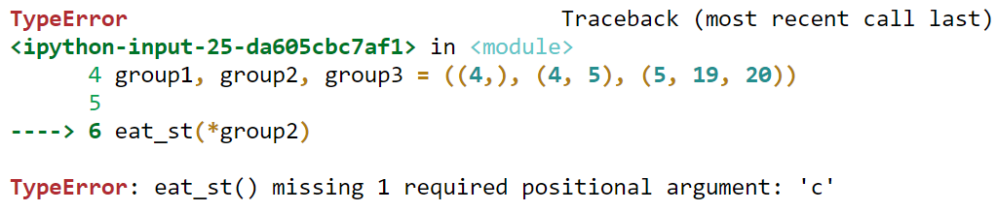
Class practice

Slide 11
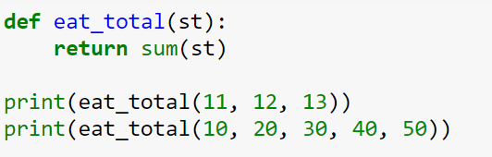
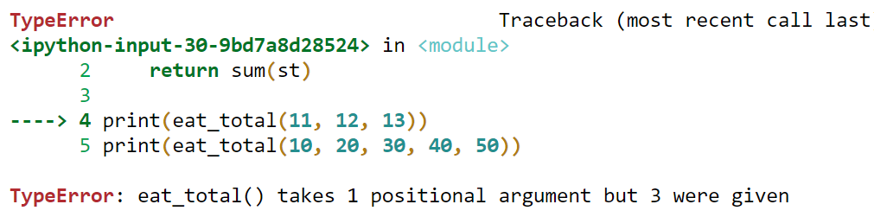
Class practice
eat_total(*st)
With * operator, eat_total packs all the arguments into one single variable

Slide 12
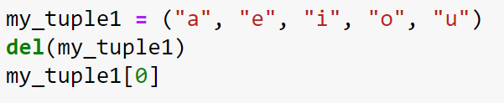
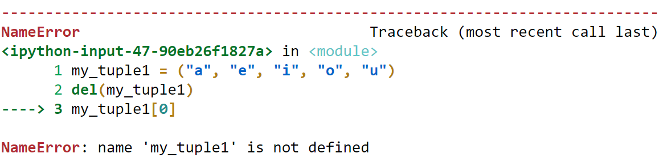
Operation on tuple: delete
tuple: similar to list but it is immutable and we cannot add, remove or change items after the tuple is defined.
BUT, we can delete the entire tuple:

Slide 13
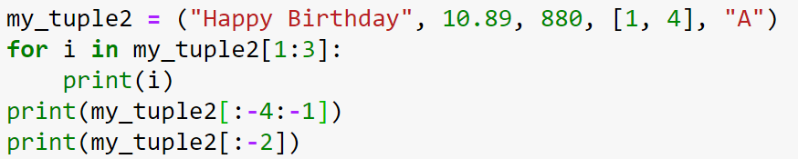
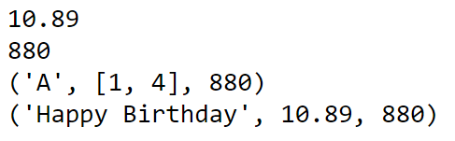
Operation on tuple: slicing
access a range of items in a tuple by using the slicing operator
similar to the slicing operators for lists:

Slide 14
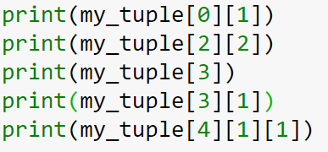
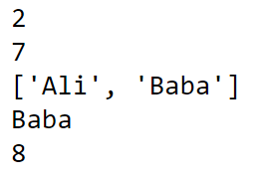
Accessing lists in tuple

Slide 15
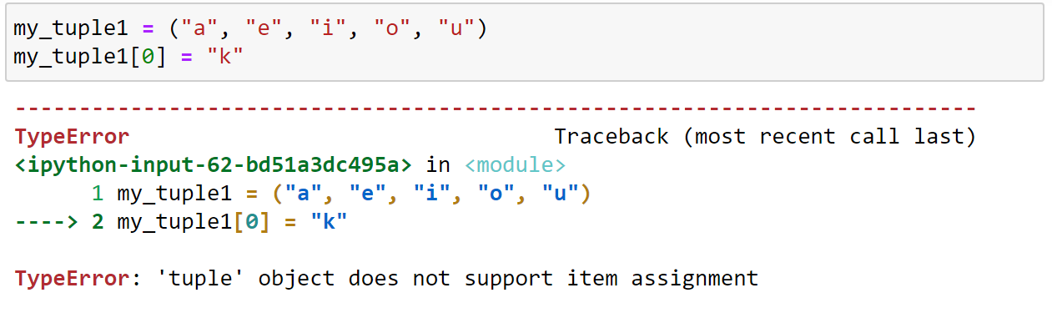
Tuple are immutable
tuples are immutable: elements of a tuple cannot be changed once they have been assigned.

Slide 16
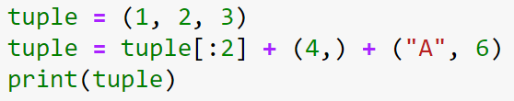

replacing a tuple
tuples are immutable: but we can replace it with a different tuple.
single element

Slide 17
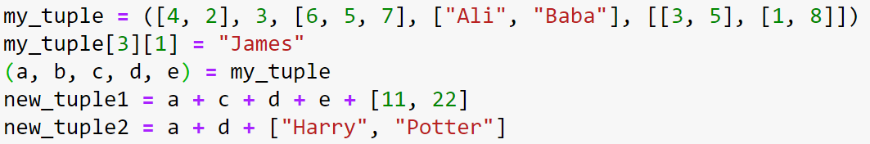


Changing a tuple
tuples are immutable but the mutable elements can be changed.
If a value within a tuple is mutable (e.g., a list), then you can change it:

Slide 18
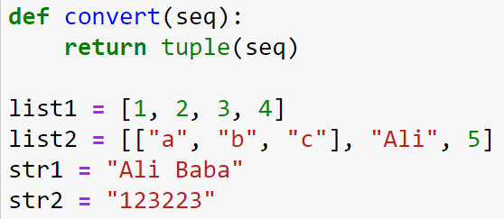
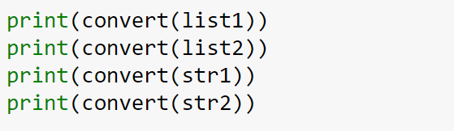
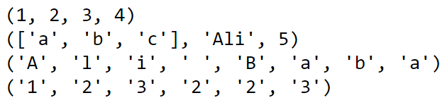
Tuple() conversion
We can convert a sequence (list or string) into a tuple:

Slide 19
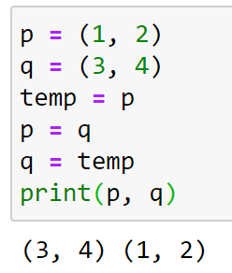
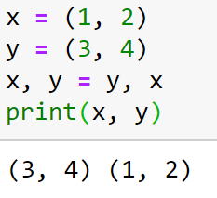
Tuple assignment
Conventional method to the values of two variables:
with tuple assignment:

Slide 20
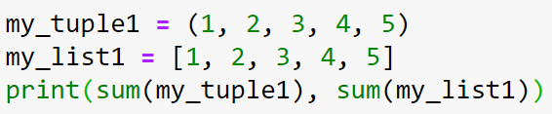

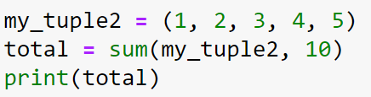

Sum() function
sum(): returns the sum of all items in an iterable

Slide 21
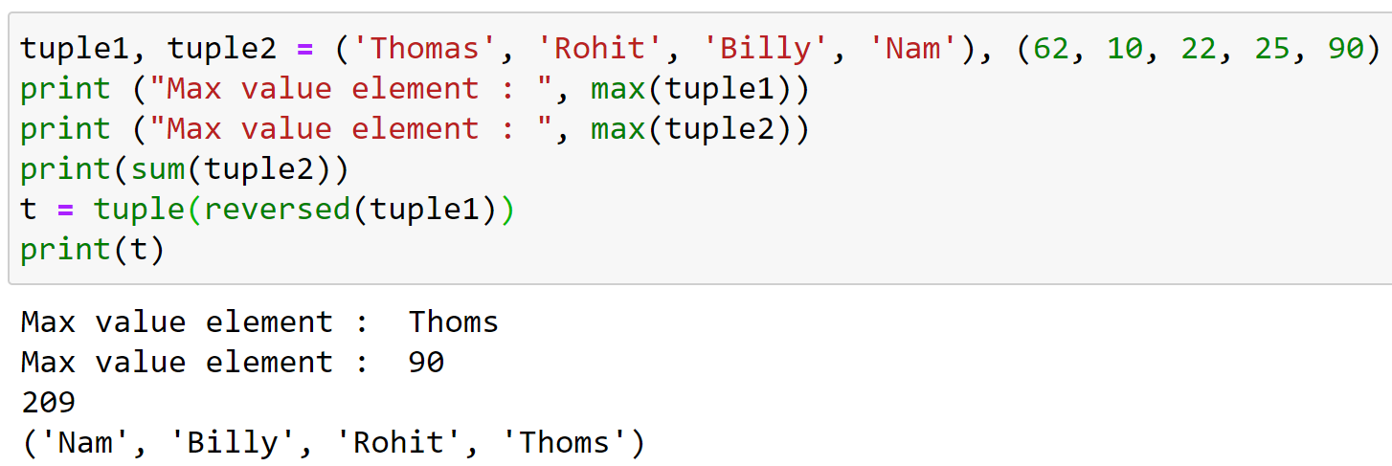


Other Built-in functions

Slide 22
Class practice
student = ("Jack", "Ali", "Baba", "James", "Thomas")
score = (43, 98, 23, 55, 41)
print(f"Total {len(student)} students in the student tuple")
print(f"The largest item is {max(student)}")
print(f"The largest score is {max(score)}")

Slide 23
Lists vs tuples: similarities
Lists and tuples are two of the most commonly used data structures in Python (with dictionary being the third).
They are both sequence data types that store a collection of items/elements.
They can store items of any data type.
Any item in the list or tuple is accessible via its index.

Slide 24
Lists vs tuples: differences
Syntax difference: list -> [], tuple -> ()
Lists are mutable while tuples are immutable (“write-protect”).
Cannot use list as a key in a dictionary, but tuple can be used as dictionary keys.
Tuple is stored in a single block of memory while list is stored in two blocks of memory.

Slide 25
dictionaries

Slide 26
Python dictionary
Dictionary format:
Colon: to separate a key from its value
key
my_dictionary = {"A":90, "B":80, "C":70, "F":40}
value
enclose keys and values with a curly brackets
separate items with a comma (,)

Slide 27
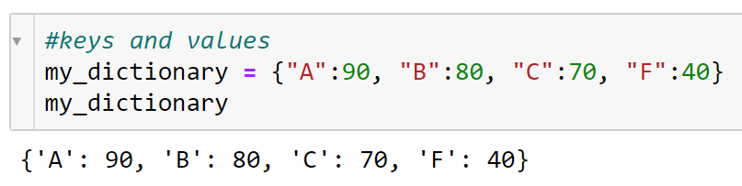
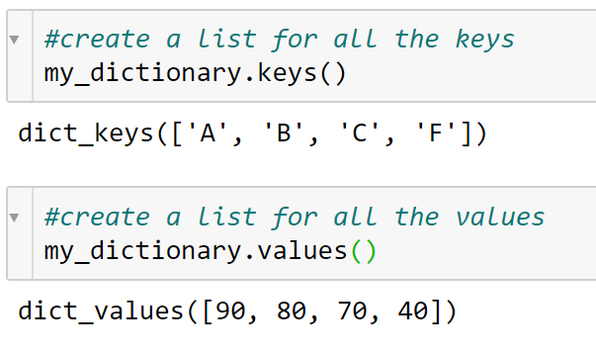
Keys and values

Slide 28
Extracting values from dictionary
Dictionary values are accessed by key
>>> my_dictionary = {"A":90, "B":80, "C":70, "F":40}
>>> "A" in my_dictionary
True
>>> my_dictionary["A"]
90

Slide 29
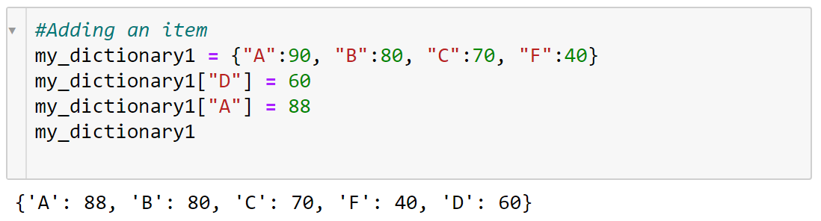
Adding and modifying an item

Slide 30
Dictionary update()
add element(s) to the dictionary if the key is not in the dictionary.
If the key exists, it updates the key with a new value.
<dictionary1>.update(<dictionary2>)

Slide 31
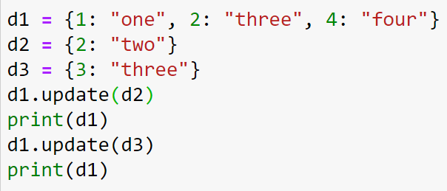

Update()

Slide 32
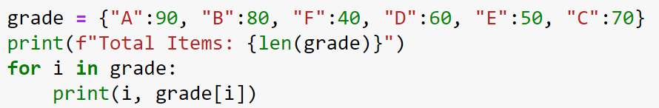
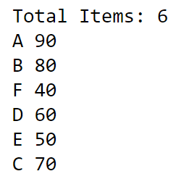
Dictionary and for-loop
Length: the number of items
Not ordered!

Slide 33
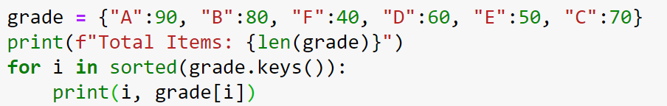
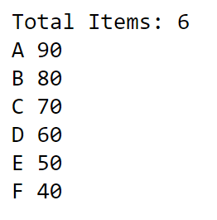
Sorting by keys
Ordered by keys!

Slide 34
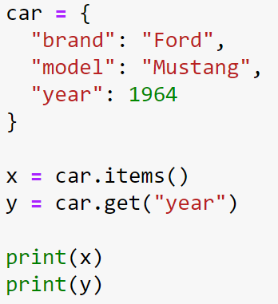
Items() function
item(): to get a list of tuples with key-pair values
[source]

Slide 35
Convert lists into key:value pair
my_keys = ["Staff ID", "Staff Name", "Department", "Office"]
my_values = ["100955885", "Ali Baba", "Finance", "Room 1002"]
?
dictionary : {'Staff ID': '100955885', 'Staff Name': 'Ali Baba', 'Department': 'Finance', 'Office': 'Room 1002'}

Slide 36
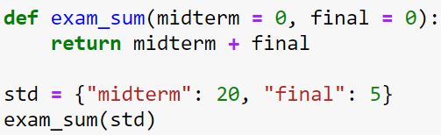
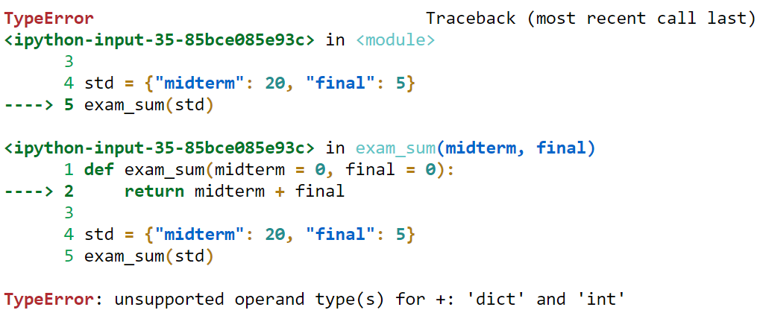
Class practice

